Slide 1


AFRI SA
Personal Empowerment
A South African movement advancing human rights, business empowerment and shared prosperity — from only R69 per month.
afrisa.life

Slide 2
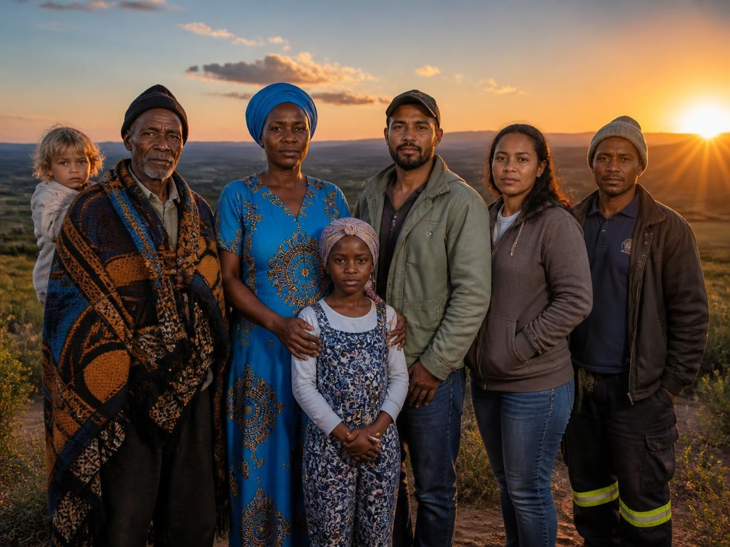
WHO WE ARE
A movement, not
just a membership
Afri SA is a South African digital enterprise and personal-empowerment movement, managed by Royce Group (Pty) Ltd.
We give ordinary South Africans affordable access to online advertising, business support, education, lifestyle benefits and a genuine share of the profits they help create.
Head office: R509 Road, Syferbult 0332, North West Province.
afrisa.life
2

Slide 3
VISION & MISSION
Why Afri SA exists
Our Vision
Our Mission
A South Africa of opportunity, dignity and shared prosperity — where every citizen can participate meaningfully in the digital economy.
To empower members through affordable advertising, practical business support and a transparent profit share that rewards participation.
Managed by Royce Group (Pty) Ltd — part of the wider Royce Eco-System.
afrisa.life
3

Slide 4
WHAT GUIDES US
Our values
Integrity
Empowerment
Innovation
Honesty and transparency in every activity.
Opportunities for people and businesses to grow.
Technology and strategy that stay relevant.
Unity in Diversity
Accountability
Long-Term Vision
Cooperation across cultures and communities.
Responsible leadership in society's interest.
Sustainable systems with enduring value.
afrisa.life
4

Slide 5
MEMBERSHIP
One small monthly amount
R69
Full Afri SA PLUS membership
Daily advertising of your business
Participation in the Profit Share Plan
Access to the Rewards Program
Discounted holidays and services
The whole Royce Eco-System
per month — everything included
No hidden fees. No extra costs.
afrisa.life
5

Slide 6
PLUS MEMBERSHIP BENEFITS
What you receive
01
Full Afri SA Membership
Immediate full membership, with access to every benefit listed on the Afri SA website.
02
Discounted Holiday Accommodation
Up to 50% off accommodation at popular timeshare resorts across Southern Africa via Fantastic Vacations.
03
Property Referral Rewards
R7,500 guaranteed for every referred property owner (properties from R750,000) who wishes to sell.
afrisa.life
6

Slide 7
PLUS MEMBERSHIP BENEFITS
What you receive (continued)
04
Advertising & Marketing Support
Ongoing access to the benefits of our Service Pack 3 advertising package.
05
Negotiated Service Rates
Every service on our Services page at negotiated, discounted member rates.
06
Networking Opportunities
Monthly online Business Networking Meetings on Google Meet to promote your business.
afrisa.life
7

Slide 8

YOUR REACH AS A MEMBER
An audience, ready-made
2 000+
100+
35+
business owners across Gauteng, Limpopo, Mpumalanga, Free State and North West
active business owners in our live WhatsApp community, growing monthly
classified categories on Snuffelgids, plus Facebook and ClickandShare.NET
afrisa.life
8

Slide 9
PROFIT SHARE PLAN
A 2x11 forced matrix
Advertise with Afri SA for R69 per month and share in the profits your growing network creates. Eleven levels, built together.
Affordability
Faster growth
Only R69 per month. No hidden fees, no extra costs.
Low-cost entry means rapid network expansion.
Superior potential
Homegrown
Outpaces global plans relative to our entry cost.
Founded in South Africa for accessible wealth creation.
afrisa.life
9

Slide 10
PROFIT SHARE PLAN
Earnings per level
LEVEL | PER SALE | NOTE
Levels 1 – 4 | N/A | Building your matrix channel
Level 5 | R11.50 | Upgrade to PRO membership
Level 6 | R156.25 | Per sale in your matrix channel
Level 7 | R179.69 | Per sale in your matrix channel
Level 8 | R206.64 | Gold Card Achiever status unlocked
Level 9 | R237.64 | Gold Card Achievers earn per sale
Level 10 | R273.28 | Upgrade to Premium membership
Level 11 | R314.27 | Premium members earn per sale
LEVEL
PER SALE
NOTE
Earnings depend on activity and team building. No income is guaranteed — see the full disclaimer on afrisa.life.
afrisa.life
10

Slide 11
REWARDS PROGRAM
Gold Card Achiever rewards
Passive income for life
A lifelong, recurring profit share income while you remain an active member.
Medical & hospital cover
Provided via Discovery Health or another authorised provider.
Funeral cover
Provided via an Afri SA authorised funeral services provider.
Free 7-day annual holiday
Accommodation provided via Fantastic Vacations.
Tertiary bursaries
100% subsidised study funding for the achiever's direct family. T&Cs apply.
Gold Card status is reached on filling level 8 of the forced matrix.
afrisa.life
11

Slide 12
REWARDS PROGRAM
Premium member rewards
REWARD 1
REWARD 2
A Prestigious Motor Vehicle
A Dream Home
Value of up to R1 million
Value of up to R5 million
Premium status follows level 10 of the matrix. Terms and conditions apply.
afrisa.life
12

Slide 13
MEMBER SERVICES
More than advertising
Business Consulting
Service Pack 3
Classifieds | Snuffelgids
Professional online Sales, Marketing and Sales Training consulting for South African business owners via Google Meet and WhatsApp.
The PLUS advertising package — daily full-colour ads in the WhatsApp community and weekly sharing on our Facebook groups.
Online classifieds from R60 per month for up to 60 words, across 35+ categories. Members receive one free ad every month.
Plus RoyceLearn Homeschool Academy — CambriLearn CAPS, British and US online curricula for ages 4 to 18.
afrisa.life
13

Slide 14
GETTING STARTED
Join in three steps
1
Tell us who introduced you
Click JOIN on afrisa.life and complete the short introducer form so your sponsor is credited.
2
Complete the debit order form
Authorise your R69 monthly membership securely on the website.
3
Pay your first R69
You are taken to the secure checkout, and your membership starts immediately.
afrisa.life
14

Slide 15
Come and build with us
afrisa.life
EMAIL
PHONE
HEAD OFFICE
afrisalife@outlook.com
+27 74 016 6695
R509 Road, Syferbult 0332, North West
Afri SA — Personal Empowerment · Managed by Royce Group (Pty) Ltd

